Slide 1
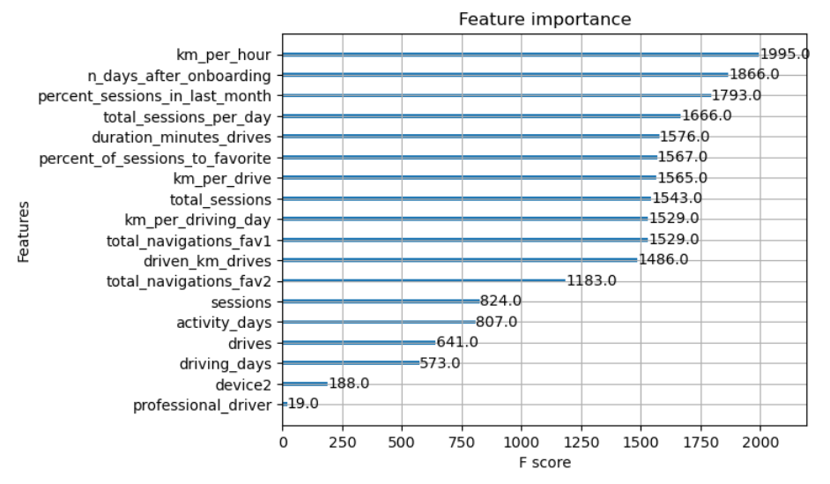
User Churn Project: Machine Learning Model Results
Executive Summary prepared for Waze leadership team
Waze leadership ask data team to develop a churn predictive model that will help prevent churn. improve user retention, and grow Waze’s business.
The final goal of this project is to develop machine learning model that predicts user churn, which quantifies the number of users who installed or stopped using the app.
This report is made by Waze data team after performing two machine learning models, Random Forest model and XGBoost model.
To obtain a model with highest predictive power, the Waze data team develop two different models to cross-compare the results: Random Forest model and XGBoost model.
The data was split into training, validation and test sets. Splitting the data into three sets means there is less data available to train the model than splitting just two sets. However, selecting best model with separate validation set enables testing of champion model by itself on the test set, which gives a better estimate of future performance than splitting data into two sets and selecting champion model by performance on the test data.
The machine learning models developed demonstrate a need for additional data in order to more accurately predict user churn.
This model confirms that the current data is insufficient to consistently predict churn. It would be better to have user information, such as drive times of day, geographic locations, etc.
Engineered features are proven valuable tool for improving of machine learning models, the Waze team recommends a second iteration of the user churn project.
Engineered features accounted for six of the top 10 features, which are: km_per_hour, percent_sessions_in_last_month, total_sessions_per_day, percent_of_drives_to_favorite, km_per_drive, and km_per_driving_day.
The XGBoost model fit the data better than Random Forest model (17.35% vs 12.68%)
The ensembles of tree-based models in this project are more valuable than a singular logistic regression model (9% score), because they achieve higher scores across all evaluation metrics and require less preprocessing of data. However, it is more difficult to understand how they make their predictions.

